Slide 1
Quantum Computing
Kien Vo

Slide 2
Overview
Introduction and History
Classical vs. Quantum Computing
Importance of Quantum Computing
Challenges and Future of Quantum Computing
Conclusion

Slide 3
Introduction
What is a quantum computer?
A quantum computer is a machine that performs calculations based on the laws of quantum mechanics, which is the behavior of particles at the sub-atomic level.

Slide 4
Introduction
History
The Theoretical Foundations of Quantum Computing (1900–1980)
The Emergence of Quantum Computing (1980–1994)
The Development of Quantum Algorithms (1994–2000)
The Race to Build Quantum Computers (2000–2021)
Ongoing Advancements (2021–present)

Slide 5
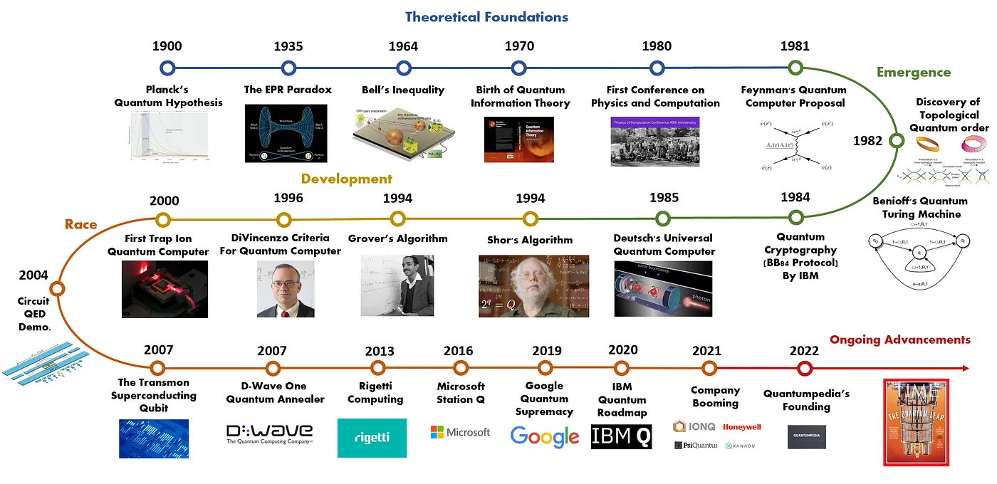

Introduction
History

Slide 6
Overview
Introduction and History
Classical vs. Quantum Computing
Importance of Quantum Computing
Challenges and Future of Quantum Computing
Conclusion

Slide 7
Classic Computers:
Classic computers are the ones we use every day.
They process data inputted in human language (letters, numbers, drawings) by converting it into machine language, which is binary (0s and 1s).
Computers perform tasks by following specific programming and calculations accurately using this binary system.

Slide 8
Quantum Computing:
Quantum computing does not rely on the conventional binary system (0 and 1) like classic computers.
It operates based on the principles of quantum mechanics.
Key concepts in quantum mechanics used in quantum computing are quantum superposition and entanglement.
These principles allow quantum computers to perform calculations in ways that are fundamentally different from classical computers.

Slide 9
Overview
Introduction and History
Classical vs. Quantum Computing
Importance of Quantum Computing
Challenges and Future of Quantum Computing
Conclusion

Slide 10
Why is Quantum Computing Important?
Quantum computers can solve certain problems much faster than classical computers.
Random Circuit Sampling calculation

Slide 11
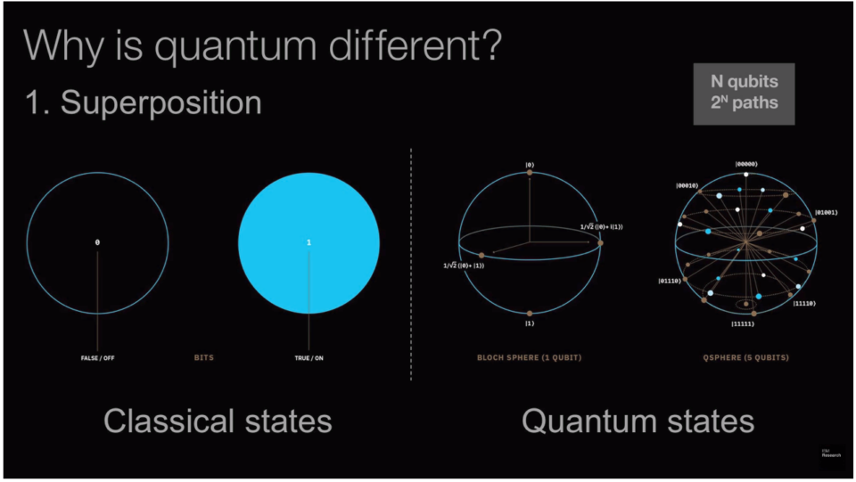
Why is Quantum Computing Important?
SUMMIT was the fastest supercomputer, needing up to 10,000 years for random circuit sampling.
Google's Sycamore, a quantum computer, completed the same task in 3 minutes and 20 seconds.

Slide 12
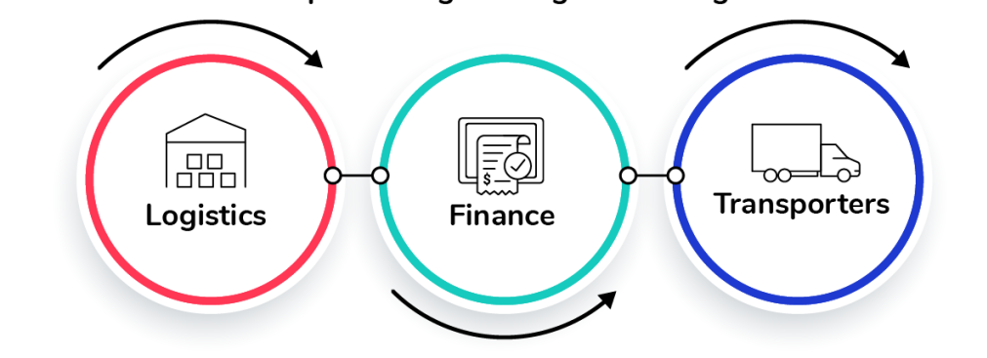
Why is Quantum Computing Important?
Complex problem solving: Quantum computing excels at solving complex optimization problems and simulations

Slide 13
Overview
Introduction and History
Classical vs. Quantum Computing
Importance of Quantum Computing
Challenge and Future
Conclusion and Open Questions

Slide 14
Challenges:
Error Rates:
Quantum systems are highly sensitive to environmental disturbances (noise, temperature fluctuations, etc.).
These disturbances cause qubits to lose their quantum state, leading to errors in calculations.
Cost:
Quantum computers are currently very expensive to develop and maintain.
Specialized hardware, cryogenic cooling systems, and operational costs contribute to the high expense.

Slide 15
Future:
Commercial Use:
Potential for widespread use in various industries once technical challenges are addressed.
Applications: Cryptography, optimization, drug discovery, artificial intelligence, and material science.
Companies Involved: IBM, Google, Microsoft, and Honeywell are investing heavily in making quantum computing commercially viable.

Slide 16
Overview
Introduction and History
Classical vs. Quantum Computing
Importance of Quantum Computing
Challenge and Future
Conclusion

Slide 17
Conclusion
Summary:
Quantum computing represents a significant shift in computational capability.
Its principles of superposition, entanglement, and interference offer new ways to solve problems.
While still in early stages, its potential applications in cryptography, optimization, drug discovery, and AI are promising.

